Slide 1
Requirements Engineering Processes

Slide 2
Objectives
To describe the principal requirements engineering activities and their relationships
To introduce techniques for requirements elicitation and analysis
To describe requirements validation and the role of requirements reviews
To discuss the role of requirements management in support of other requirements engineering processes

Slide 3
Topics covered
Feasibility studies
Requirements elicitation and analysis
Requirements validation
Requirements management

Slide 4
Requirements engineering processes
The processes used for RE vary widely depending on the application domain, the people involved and the organisation developing the requirements.
However, there are a number of generic activities common to all processes
  Requirements elicitation;
  Requirements analysis;
  Requirements validation;
  Requirements management.

Slide 5
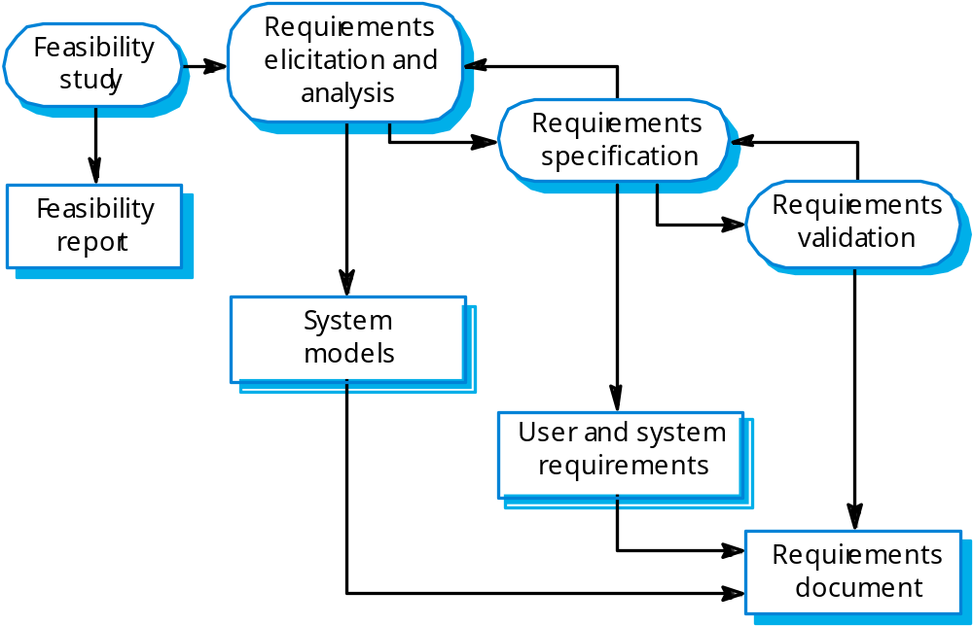
The requirements engineering process

Slide 6
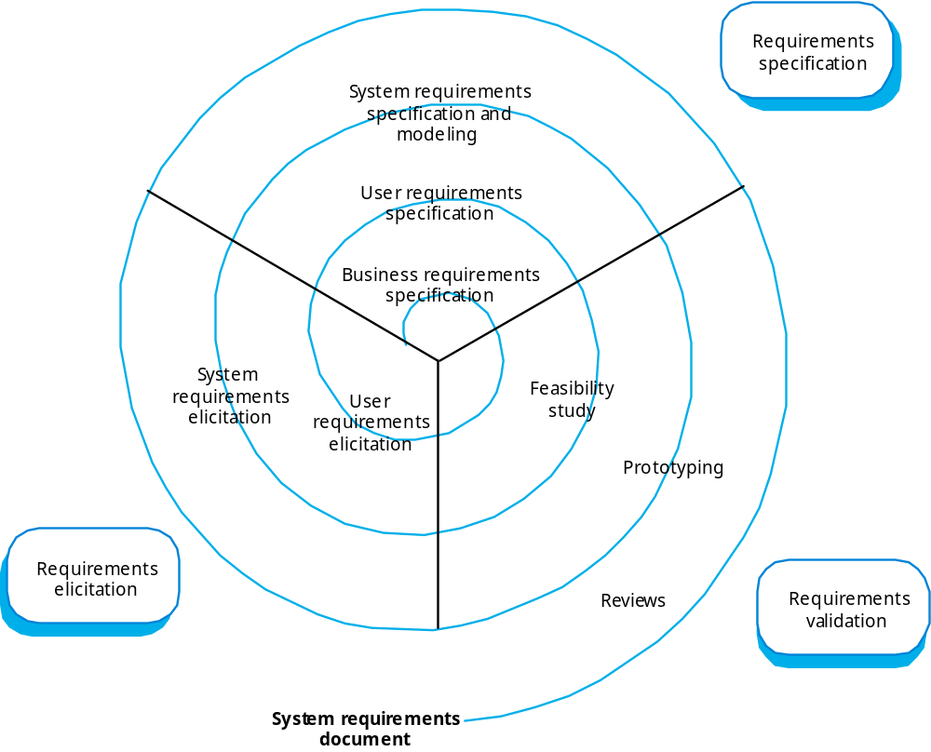
Requirements engineering

Slide 7
Feasibility studies
A feasibility study decides whether or not the proposed system is worthwhile.
A short focused study that checks
  If the system contributes to organisational objectives;
  If the system can be engineered using current technology and within budget;
  If the system can be integrated with other systems that are used.

Slide 8
Feasibility study implementation
Based on information assessment (what is required), information collection and report writing.
Questions for people in the organisation
  What if the system wasn’t implemented?
  What are current process problems?
  How will the proposed system help?
  What will be the integration problems?
  Is new technology needed? What skills?
  What facilities must be supported by the proposed system?

Slide 9
Elicitation and analysis
Sometimes called requirements elicitation or requirements discovery.
Involves technical staff working with customers to find out about the application domain, the services that the system should provide and the system’s operational constraints.
May involve end-users, managers, engineers involved in maintenance, domain experts, trade unions, etc. These are called stakeholders.

Slide 10
Problems of requirements analysis
Stakeholders don’t know what they really want.
Stakeholders express requirements in their own terms.
Different stakeholders may have conflicting requirements.
Organisational and political factors may influence the system requirements.
The requirements change during the analysis process. New stakeholders may emerge and the business environment change.

Slide 11
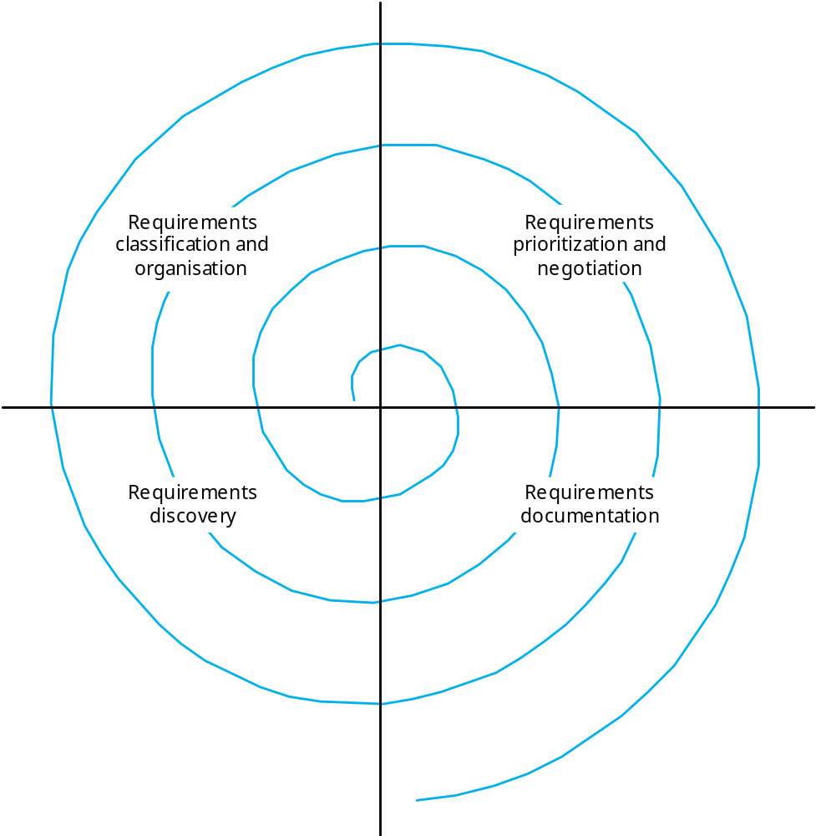
The requirements spiral

Slide 12
Process activities
Requirements discovery
  Interacting with stakeholders to discover their requirements. Domain requirements are also discovered at this stage.
Requirements classification and organisation
  Groups related requirements and organises them into coherent clusters.
Prioritisation and negotiation
  Prioritising requirements and resolving requirements conflicts.
Requirements documentation
  Requirements are documented and input into the next round of the spiral.

Slide 13
Requirements discovery
The process of gathering information about the proposed and existing systems and distilling the user and system requirements from this information.
Sources of information include documentation, system stakeholders and the specifications of similar systems.

Slide 14
ATM stakeholders
Bank customers
Representatives of other banks
Bank managers
Counter staff
Database administrators
Security managers
Marketing department
Hardware and software maintenance engineers
Banking regulators

Slide 15
Viewpoints
Viewpoints are a way of structuring the requirements to represent the perspectives of different stakeholders. Stakeholders may be classified under different viewpoints.
This multi-perspective analysis is important as there is no single correct way to analyse system requirements.

Slide 16
Types of viewpoint
Interactor viewpoints
  People or other systems that interact directly with the system. In an ATM, the customer’s and the account database are interactor VPs.
Indirect viewpoints
  Stakeholders who do not use the system themselves but who influence the requirements. In an ATM, management and security staff are indirect viewpoints.
Domain viewpoints
  Domain characteristics and constraints that influence the requirements. In an ATM, an example would be standards for inter-bank communications.

Slide 17
Viewpoint identification
Identify viewpoints using
  Providers and receivers of system services;
  Systems that interact directly with the system being specified;
  Regulations and standards;
  Sources of business and non-functional requirements.
  Engineers who have to develop and maintain the system;
  Marketing and other business viewpoints.

Slide 18
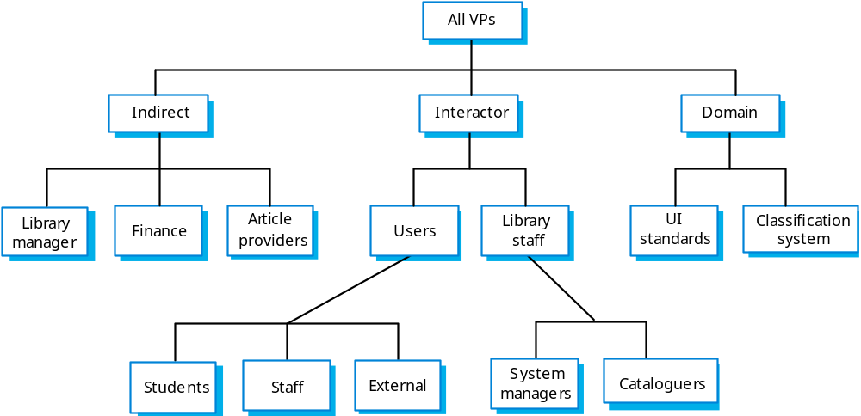
LIBSYS viewpoint hierarchy

Slide 19
Interviewing
In formal or informal interviewing, the RE team puts questions to stakeholders about the system that they use and the system to be developed.
There are two types of interview
  Closed interviews where a pre-defined set of questions are answered.
  Open interviews where there is no pre-defined agenda and a range of issues are explored with stakeholders.

Slide 20
Interviews in practice
Normally a mix of closed and open-ended interviewing.
Interviews are good for getting an overall understanding of what stakeholders do and how they might interact with the system.
Interviews are not good for understanding domain requirements
  Requirements engineers cannot understand specific domain terminology;
  Some domain knowledge is so familiar that people find it hard to articulate or think that it isn’t worth articulating.

Slide 21
Effective interviewers
Interviewers should be open-minded, willing to listen to stakeholders and should not have pre-conceived ideas about the requirements.
They should prompt the interviewee with a question or a proposal and should not simply expect them to respond to a question such as ‘what do you want’.

Slide 22
Scenarios
Scenarios are real-life examples of how a system can be used.
They should include
  A description of the starting situation;
  A description of the normal flow of events;
  A description of what can go wrong;
  Information about other concurrent activities;
  A description of the state when the scenario finishes.

Slide 23
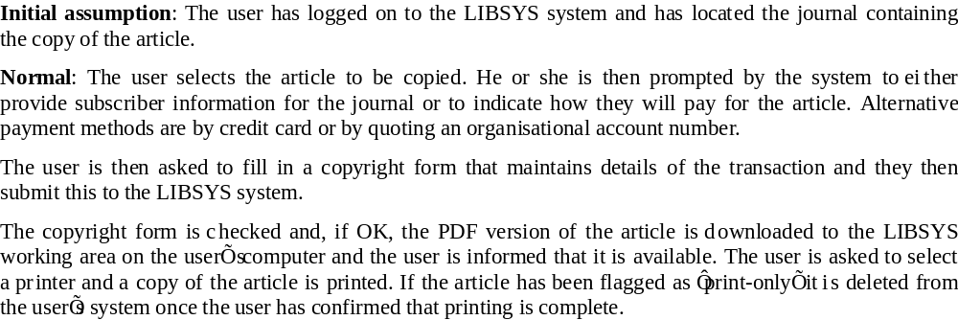
LIBSYS scenario (1)

Slide 24
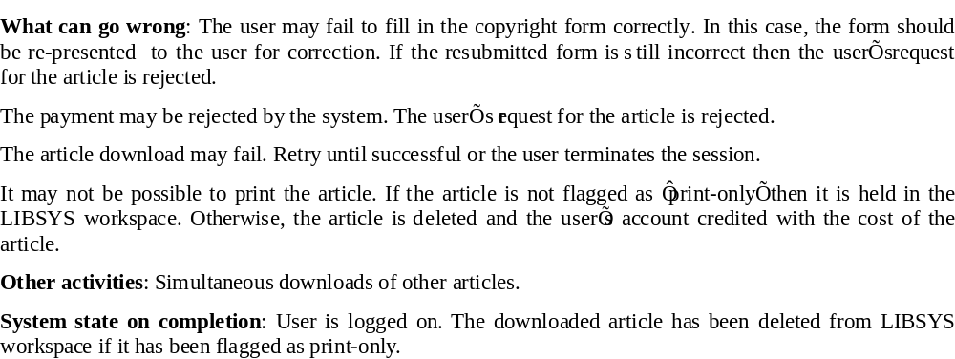
LIBSYS scenario (2)

Slide 25
Use cases
Use-cases are a scenario based technique in the UML which identify the actors in an interaction and which describe the interaction itself.
A set of use cases should describe all possible interactions with the system.
Sequence diagrams may be used to add detail to use-cases by showing the sequence of event processing in the system.

Slide 26
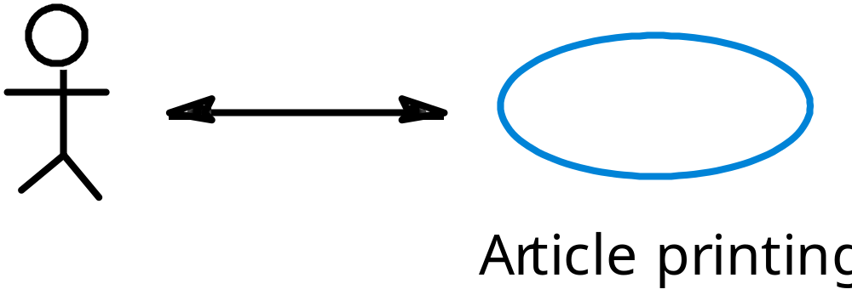
Article printing use-case

Slide 27
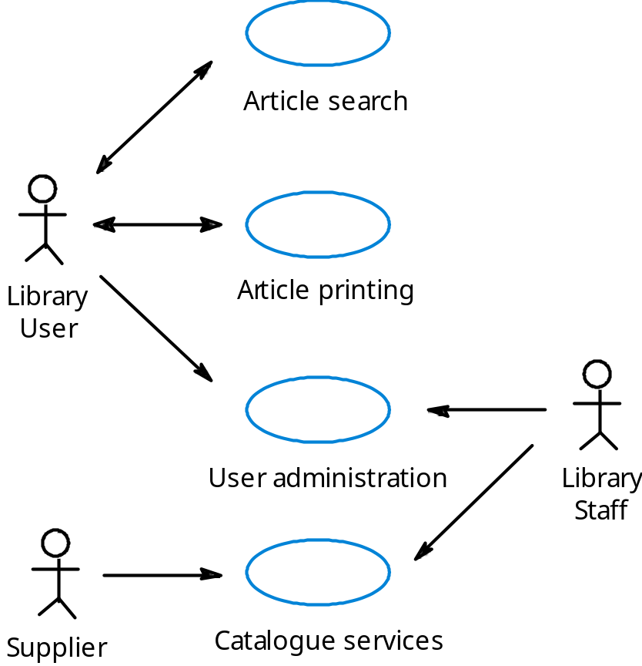
LIBSYS use cases

Slide 28
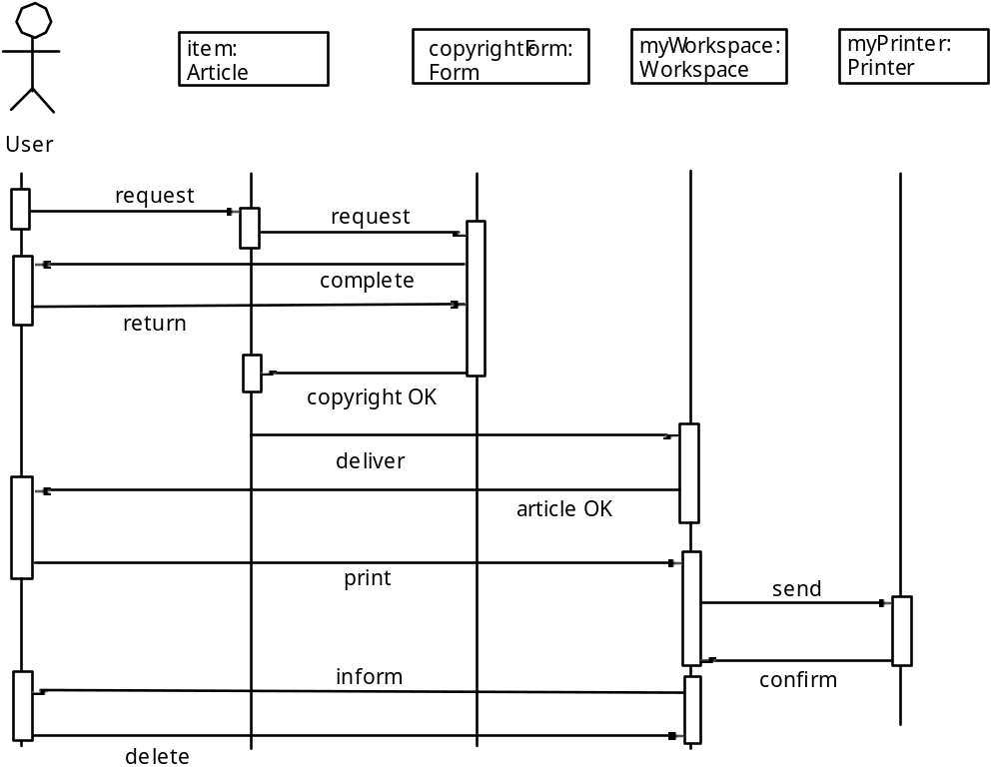
Article printing

Slide 29
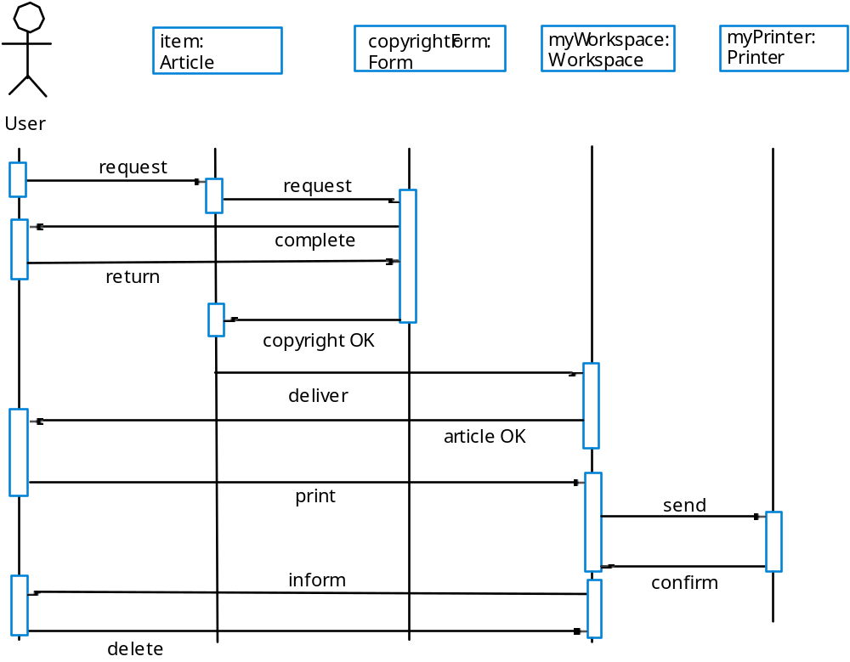
Print article sequence

Slide 30
Social and organisational factors
Software systems are used in a social and organisational context. This can influence or even dominate the system requirements.
Social and organisational factors are not a single viewpoint but are influences on all viewpoints.
Good analysts must be sensitive to these factors but currently no systematic way to tackle their analysis.

Slide 31
Ethnography
A social scientists spends a considerable time observing and analysing how people actually work.
People do not have to explain or articulate their work.
Social and organisational factors of importance may be observed.
Ethnographic studies have shown that work is usually richer and more complex than suggested by simple system models.

Slide 32
Focused ethnography
Developed in a project studying the air traffic control process
Combines ethnography with prototyping
Prototype development results in unanswered questions which focus the ethnographic analysis.
The problem with ethnography is that it studies existing practices which may have some historical basis which is no longer relevant.

Slide 33
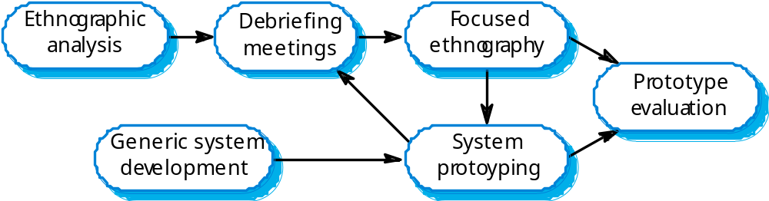
Ethnography and prototyping

Slide 34
Scope of ethnography
Requirements that are derived from the way that people actually work rather than the way I which process definitions suggest that they ought to work.
Requirements that are derived from cooperation and awareness of other people’s activities.

Slide 35
Requirements validation
Concerned with demonstrating that the requirements define the system that the customer really wants.
Requirements error costs are high so validation is very important
  Fixing a requirements error after delivery may cost up to 100 times the cost of fixing an implementation error.

Slide 36
Requirements checking
Validity. Does the system provide the functions which best support the customer’s needs?
Consistency. Are there any requirements conflicts?
Completeness. Are all functions required by the customer included?
Realism. Can the requirements be implemented given available budget and technology
Verifiability. Can the requirements be checked?

Slide 37
Requirements validation techniques
Requirements reviews
  Systematic manual analysis of the requirements.
Prototyping
  Using an executable model of the system to check requirements. Covered in Chapter 17.
Test-case generation
  Developing tests for requirements to check testability.

Slide 38
Requirements reviews
Regular reviews should be held while the requirements definition is being formulated.
Both client and contractor staff should be involved in reviews.
Reviews may be formal (with completed documents) or informal. Good communications between developers, customers and users can resolve problems at an early stage.

Slide 39
Review checks
Verifiability. Is the requirement realistically testable?
Comprehensibility. Is the requirement properly understood?
Traceability. Is the origin of the requirement clearly stated?
Adaptability. Can the requirement be changed without a large impact on other requirements?

Slide 40
Requirements management
Requirements management is the process of managing changing requirements during the requirements engineering process and system development.
Requirements are inevitably incomplete and inconsistent
  New requirements emerge during the process as business needs change and a better understanding of the system is developed;
  Different viewpoints have different requirements and these are often contradictory.

Slide 41
Requirements change
The priority of requirements from different viewpoints changes during the development process.
System customers may specify requirements from a business perspective that conflict with end-user requirements.
The business and technical environment of the system changes during its development.

Slide 42
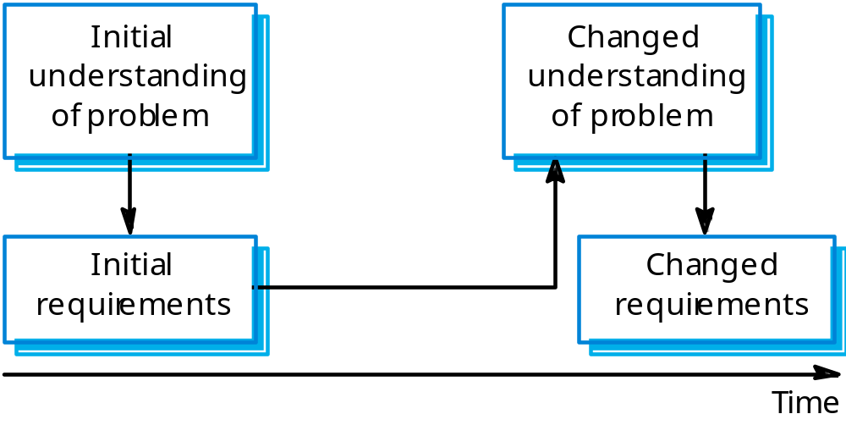
Requirements evolution

Slide 43
Enduring and volatile requirements
Enduring requirements. Stable requirements derived from the core activity of the customer organisation. E.g. a hospital will always have doctors, nurses, etc. May be derived from domain models
Volatile requirements. Requirements which change during development or when the system is in use. In a hospital, requirements derived from health-care policy

Slide 44
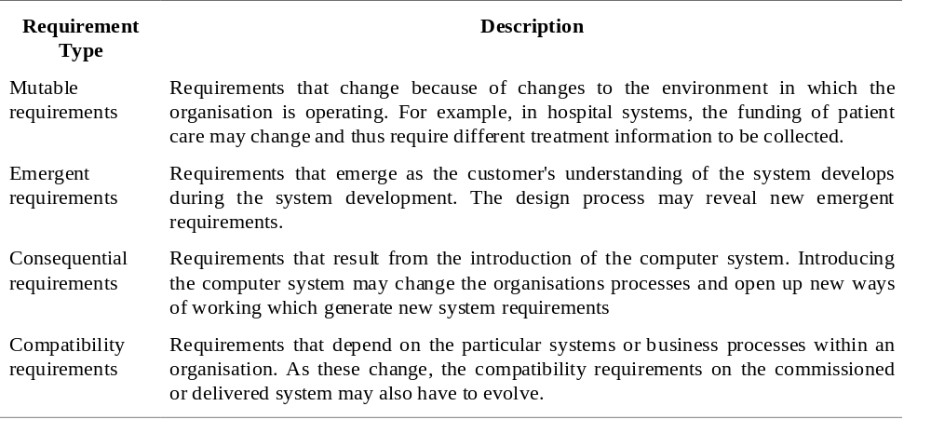
Requirements classification

Slide 45
Requirements management planning
During the requirements engineering process, you have to plan:
  Requirements identification
    How requirements are individually identified;
  A change management process
    The process followed when analysing a requirements change;
  Traceability policies
    The amount of information about requirements relationships that is maintained;
  CASE tool support
    The tool support required to help manage requirements change;

Slide 46
Traceability
Traceability is concerned with the relationships between requirements, their sources and the system design
Source traceability
  Links from requirements to stakeholders who proposed these requirements;
Requirements traceability
  Links between dependent requirements;
Design traceability
  Links from the requirements to the design;

Slide 47
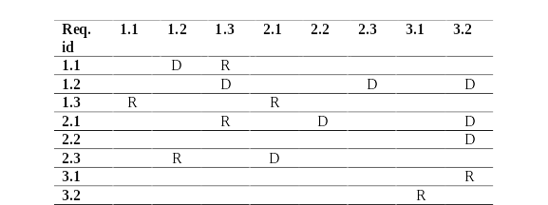
A traceability matrix

Slide 48
CASE tool support
Requirements storage
  Requirements should be managed in a secure, managed data store.
Change management
  The process of change management is a workflow process whose stages can be defined and information flow between these stages partially automated.
Traceability management
  Automated retrieval of the links between requirements.

Slide 49
Requirements change management
Should apply to all proposed changes to the requirements.
Principal stages
  Problem analysis. Discuss requirements problem and propose change;
  Change analysis and costing. Assess effects of change on other requirements;
  Change implementation. Modify requirements document and other documents to reflect change.

Slide 50
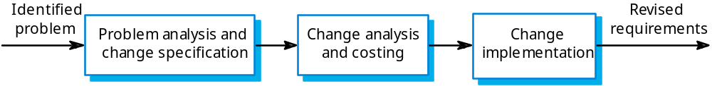
Change management

Slide 51
Key points
The requirements engineering process includes a feasibility study, requirements elicitation and analysis, requirements specification and requirements management.
Requirements elicitation and analysis is iterative involving domain understanding, requirements collection, classification, structuring, prioritisation and validation.
Systems have multiple stakeholders with different requirements.

Slide 52
Key points
Social and organisation factors influence system requirements.
Requirements validation is concerned with checks for validity, consistency, completeness, realism and verifiability.
Business changes inevitably lead to changing requirements.
Requirements management includes planning and change management.

